Slide 1
www.aaacf.org/scholarships

Slide 2
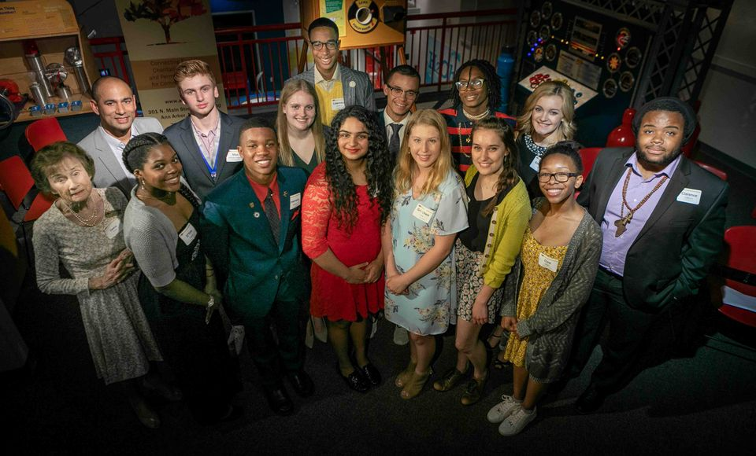
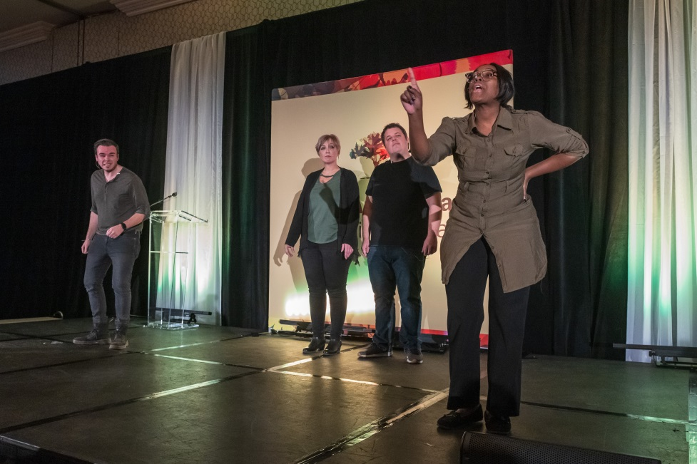
About AAACF
Our Mission
Enrich the quality of life in our region
through knowledgeable leadership, engaged grantmaking, and creative partnerships
with donors to make philanthropic
investments and build endowment
AAACF is a tax-exempt public charity that helps individuals, families, groups, and organizations accomplish their philanthropic goals. Through a core team of 17 Trustees, a staff of 12, and 400+ volunteers, AAACF connects people, charitable causes, and permanent capital for community impact.

Slide 3
In 2018 alone, AAACF distributed over 160 scholarships totaling more than $290,000!

Slide 4
The Ann Arbor Area Community Foundation
offers 40+ scholarships
Merit
Community Involvement
Financial Need
Merit
Athletics
and MORE

Slide 5
Application Process
Undocumented students are eligible to apply for all scholarships
FAFSA completion is encouraged but not mandatory
Award amounts range from $500-$3,000
Multi-year scholarships are available
Students are not limited in the number or amount of scholarships they can receive
STEP 1: Answer the Prequalifying Questions to determine eligibility
STEP 2: Request transcript
STEP 3: Have the Recommendation Form filled out
STEP 4: Complete the online application
STEP 5: Submit the application

Slide 6
Application Components
Online Application (includes 2 essays)
Recommendation Form
Transcript
04
03
Additional Materials – if applicable
02
01

Slide 7

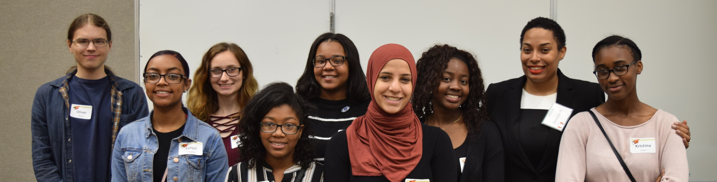
Application Deadline: March 12th @ 3 PM

Slide 8
Questions?
Please contact Maryellen Ferro
Ann Arbor Area Community Foundation
301 North Main Street, Suite 300
Ann Arbor, Michigan 48104
Phone: 734.663.0401
Email: mferro@aaacf.org
Website: aaacf.org

