Slide 1
Mood Disorders in Adolescence
Ben Biermann, M.D., Ph.D
Child and Adolescent Psychiatry
Medical Director CAPH

Slide 2
Disclosures
Dr. Biermann has no conflicts of interest to disclose.

Slide 3
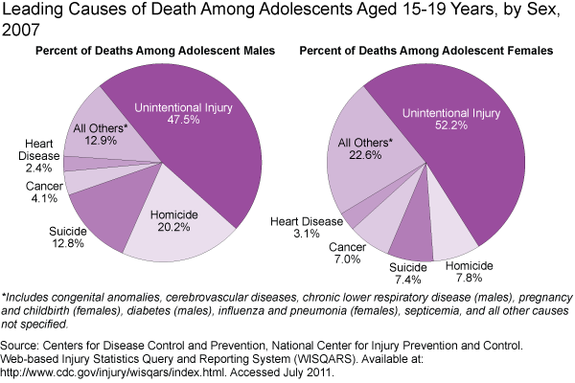

Slide 4
WHO calls for stronger focus on adolescent health.
Road traffic injuries, HIV/AIDS, suicide are top causes of death; Depression is number 1 cause of illness and disability
News release
14 May 2014 | GENEVA - WHO's "Health for the world’s adolescents" report reveals that depression is the predominant cause of illness and disability for both boys and girls aged 10 to 19 years. The top 3 causes of adolescent deaths globally are road traffic injuries, HIV/AIDS, and suicide. Worldwide, an estimated 1.3 million adolescents died in 2012.
Mental health problems take a big toll
Globally, depression is the number 1 cause of illness and disability in this age group, and suicide ranks number 3 among causes of death. Some studies show that half of all people who develop mental disorders have their first symptoms by the age of 14. If adolescents with mental health problems get the care they need, this can prevent deaths and avoid suffering throughout life.

Slide 5
Epidemiology
Prior to puberty M=F; After Puberty F>M
Rates of Depression increase with Age through out childhood and adolescence.

Slide 6
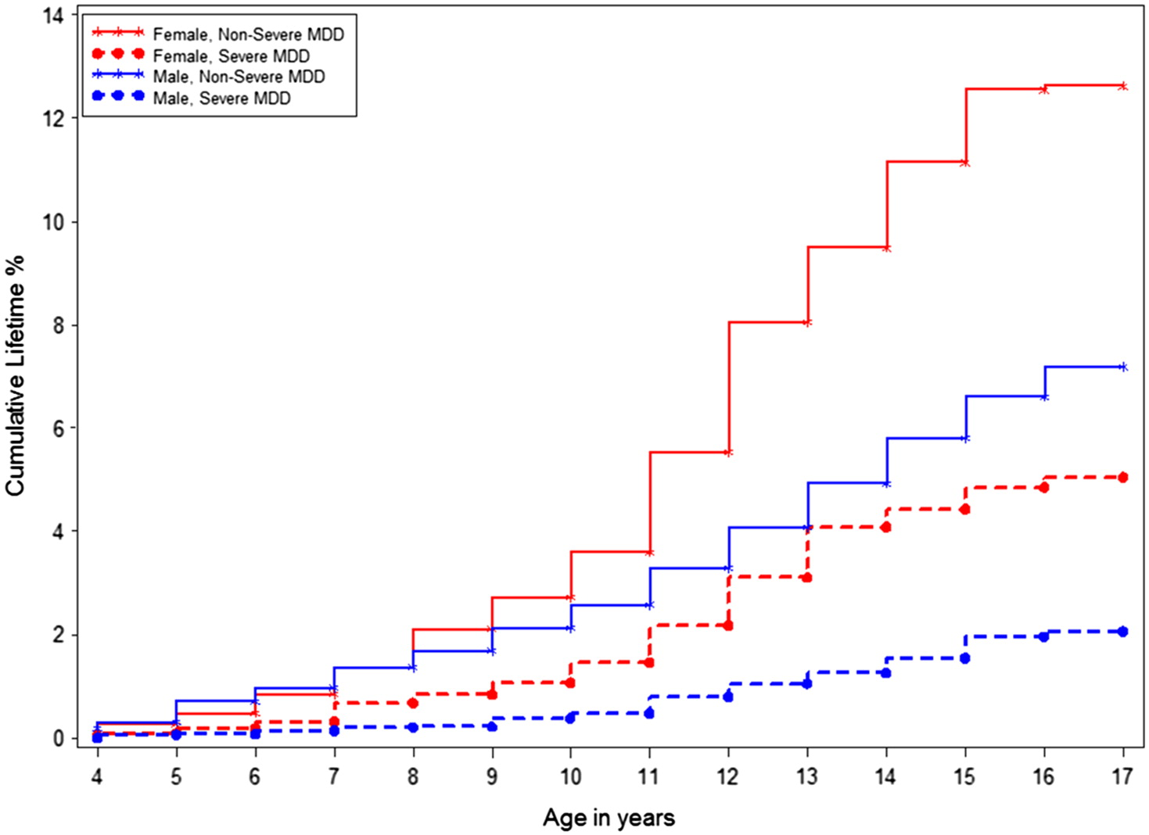
Figure 1
Journal of the American Academy of Child & Adolescent Psychiatry 2015 54, 37-44.e2DOI: (10.1016/j.jaac.2014.10.010)
Copyright © 2015 Terms and Conditions
Notes:
Cumulative lifetime prevalence of major depressive disorder (MDD) by sex and severity.

Slide 7
Depressive Disorder
Combination of :
Mood Symptoms (sadness or irritability, loss of interest)
Neurovegetative symptoms (sleep, appetite, energy)
Inappropriate guilt
Thoughts about death or suicide.
2 weeks duration
Not caused by substance use or directly related to a stressor

Slide 8
Suicide/Self-injury Risk Factors
Males 3x higher rates
Prior attempts
Ideation/planning
Mood disorder
Substance Abuse
Isolated youth at higher risk
Presence of Gun in the home

Slide 9
Treatments
Psychotherapy
Cognitive Behavior Therapy (learn to recognize thought distortions)
Dialectical Behavior Therapy (teach skills for distress tolerance, healthy coping, interpersonal effectiveness)
Medication
Combination Treatments

Slide 10
Useful Websites
American Academy of Child and Adolescent Psychiatry www.aacap.org
National Alliance for Mental Illness www.nami.org
National Institute on Mental Health www.nimh.nih.gov
National Institute on Drug Abuse www.drugabuse.gov

